Slide 1
100 Cardinal PED Presentations
Kelly D. Young, MD, MS
Program Director, PEM Fellowship
Harbor-UCLA Medical Center, Torrance, California
Health Sciences Clinical Professor of Pediatrics
David Geffen School of Medicine at UCLA
CASES 41-50

Slide 2
What is this lecture about?
Pediatric – exclusive to or commonly seen in kids
Not a Zebra (ie something I’ve either seen during my career or know has been seen in our PED)
Not a horse either – ie something you may make it through training without seeing
Emergency practitioner can make the diagnosis or at least suspect it
Emergency practitioner should make the diagnosis or at least suspect it, and can make a difference by either getting diagnostic studies, appropriate consultations, and starting initial management or by not doing unnecessary work-up

Slide 3
Quick info in 3 slides
Classic case – build on illness scripts to reinforce when you should suspect this entity
What should make you suspect this diagnosis
Basics of diagnosis and ED management
You can look it up for more detail, but you can’t look it up until you at least suspect it
FOAM resources for additional readings

Slide 4
How to use this lecture
After the initial case presentation, think about the differential diagnosis
Helpful framework: SPIT
What is the most Serious diagnosis?
What is the most Probable diagnosis?
What is the most Interesting diagnosis?
What is the most Treatable diagnosis (ie what diagnosis should the EP do something about ASAP)?
Write down what you think is the diagnosis – commit!
At the end, see how many you got right

Slide 5
2 year old with limp
2 year old boy noted to be limping for last 2 days, now this AM won’t walk at all
Tactile fever x 2 days also
No known trauma, no significant past med hx
VS Temp 38.9, HR 130, RR 24, BP 78/34
Patient prefers to hold right leg flexed, abducted, and externally rotated at hip
Decreased passive ROM at hip, full ROM at knee
No point tenderness, redness, swelling noted
Peripheral WBC 18.6, 80% N, ESR 63

Slide 6
2 year old girl with rash
2yo girl with rash that developed over 3-4 days
Hx of recent viral infection
Buttocks, thighs, knees, outer arms, face
Mucous membranes and trunk spared
Brown-red flat-topped papules 1-5mm in diameter, some appear fluid-filled
Temp 37.8, HR 110, RR 24, BP 78/44
Well appearing, nontoxic
Palpable nontender, mobile inguinal and axillary lymphadenopathy
www.crutchfielddermatology.com
www.patienthelp.org

Slide 7
2 year old with recent bloody diarrhea
2 year old previously healthy girl had bloody diarrhea and fever starting 7 days ago for which she was seen in the ED 5 days ago and treated with IV fluids
Currently in clinic for follow-up and diarrhea has improved but patient is now noted to be pale, less active / fatigued
On history, patient has also had fewer wet diapers
Diet history includes no meat but does drink unpasteurized goat milk from family goats
VS: temp 37.6, HR 120, RR 24, BP 110/55, O2 sat 100% room air
PE: pale, alert but less active than usual, no murmur, lungs clear, abdomen soft, nondistended, nontender, no rash

Slide 8
2 year old brought in after chewing on electrical cord
2 year old boy chewed on an electrical cord and sustained a burn to his oral commissure yesterday
Parents went to PMD’s office yesterday and were told to go to ED if concerned
It seems to be healing and he is in no distress, but they didn’t like the color, so came to ED
No fever, otherwise well and no evidence of other injuries

Slide 9
2 ½ year old with vomiting, altered mental status
2 ½ year old male brought in by ambulance
One day of vomiting, non-bloody, non-bilious, and increasingly altered
Patient has history of several previous ED visits for viral gastritis
Picky eater normally, went to grandparents’ house and ate some new foods, symptoms began on return from their house
Parents and grandparents deny available medications or toxins
VS temp 37.7, HR 110, RR 40, BP 78/36, weight 11.1 kg (< 5th percentile), length 90 cm (25th percentile)
Lethargic, minimally responsive, no nuchal rigidity, no rash, heart no murmur, lungs clear, abdomen benign, no hepatosplenomegaly
Family history of mom’s brother died in infancy of presumed sepsis

Slide 10
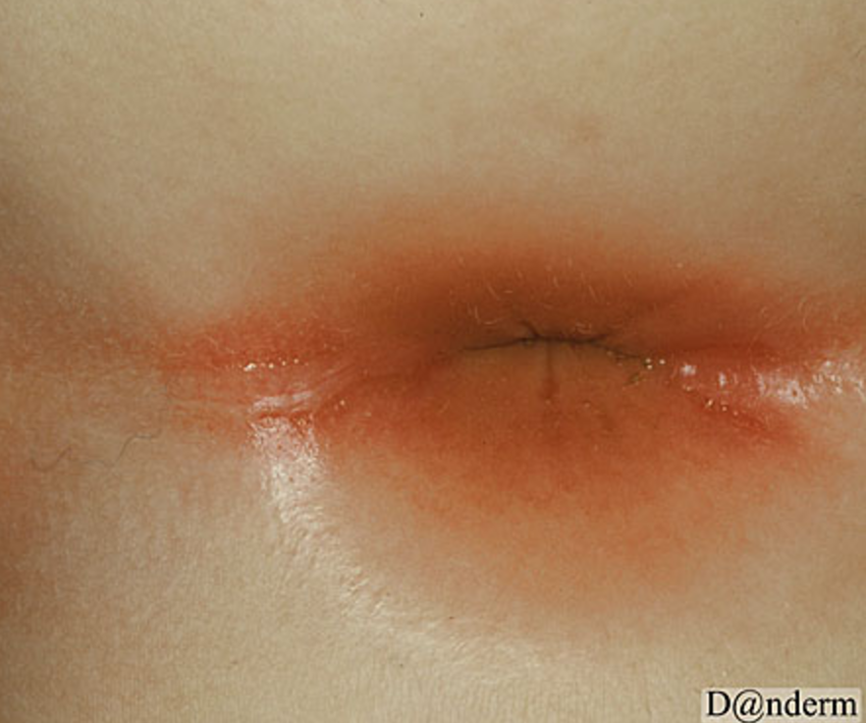
2 ½ year old girl with peri-anal rash and blood-streaked stools
2 ½ year old previously healthy girl complains of rectal area itching and pain with defecation
Mom then noticed bright red blood streaks in her stools
Area around the anus is bright red
She attends daycare and has one older sibling, age 5 years
Parents are divorced and she spends weekends with her father
Mom is unsure whether she suspects any possibility of sexual abuse
Temp 37.5, HR 98, RR 20, BP 80/35
Exam unremarkable except for well-demarcated, bright red, peri-anal rash; abdomen soft and nontender, patient well-appearing. Behavior and interactions with mom appropriate.
http://www.danderm-pdv.is.kkh.dk/atlas/5-4-4.html

Slide 11
3 year old with malodorous nasal discharge
3 year old girl with malodorous right nasal discharge x 1 week
Previously healthy, full term born NSVD, no complications
Denies fever, cough, h/o allergies, trauma, headache, foreign body
Recently started preschool last month, doing well per teachers
VS: temp 37.7, HR 90, RR 24, BP 80/45, O2 sat 99% room air
Malodorous unilateral right nasal yellow-white discharge
Left nares unremarkable, right nares after discharge bulb suctioned, mildly swollen mucosa and turbinates, no septal hematoma, no foreign body seen

Slide 12
3 year old with fever and limp
3 year old boy with fever for 6 days, complaining also of pain in right leg in the knee area and limp
No known h/o trauma, no significant past medical history
VS temp 39.4, HR 120, RR 20, BP 80/40, O2 sat 99%
Right proximal tibia with area of point tenderness with redness and warmth of overlying skin, no fluctuance, antalgic gait
FROM knee and hip joints passively
WBC 18.8, 80% N, ESR 90
Xrays of pelvis, femur, tibia, fibula negative

Slide 13
3 year old boy with sore throat, fever, neck stiffness
3yo boy with 24 hours of sore throat, fever, neck stiffness, decreased po intake
Negative PMH, no vomiting, diarrhea, headache, abdominal pain, coughing, known ill contacts
Temp 39.4, HR 150, RR 24, BP 80/40, O2 sat 97% room air
Patient ill-appearing, holding head midline and reluctant to range neck, alert and oriented
Oropharynx (quick look) erythematous, no exudate
Tender cervical lymphadenopathy

Slide 14
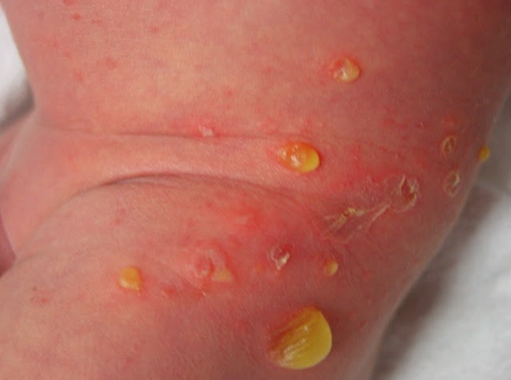
3 year old with rash
3yo boy with rash for 2 days on left lower abdomen extending onto upper outer thigh
Previously healthy, no fever, no rash contacts
Rash includes clear yellow fluid-filled bullae, some of which have ruptured and have a thin colarette of scale
Temp 37.7, HR 110, RR 20, BP 80/40, O2 sat 100%, rash as shown, remainder of exam normal

Slide 15
Did you write down what you thought the answers were? Answers on following slides

Slide 16
2 year old with limp
2 year old boy noted to be limping for last 2 days, now this AM won’t walk at all
Tactile fever x 2 days also
No known trauma, no significant past med hx
VS Temp 38.9, HR 130, RR 24, BP 78/34
Patient prefers to hold right leg flexed, abducted, and externally rotated at hip
Decreased passive ROM at hip, full ROM at knee
No point tenderness, redness, swelling noted
Peripheral WBC 18.6, 80% N, ESR 63
https://www.ahcmedia.com/articles/7863-evaluation-of-the-child-with-a-limp

Slide 17
Septic arthritis – suspect it
Increased in younger children < 2 years old
80% lower extremity, mainly hip and knee
Decreased passive range of motion, limp if lower extremity
Hip held flexed, abducted, externally rotated due to joint effusion
Visible joint effusion, erythema, warmth in elbow or knee
If child is able to indicate, pain at joint
Neonates may present with sepsis-like picture
May be local spread from minor trauma or skin infection or hematogenous spread
Must ddx from transient synovitis in hips
Kocher’s Criteria: fever, non weight-bearing, ESR > 40, peripheral WBC > 12000
0 predictors risk < 0.2%, 1 – 3%, 2 – 40%, 3– 93%, 4 – 99%
http://www.orthopaedicsone.com/display/Clerkship/What+is+septic+arthritis

Slide 18
Septic arthritis – diagnose and manage it
CBC, ESR, blood culture (positive in about 40%0
Joint aspiration for cell count, gram stain & culture
Imaging: plain radiographs and ultrasound may detect effusion
MRI is highly sensitive and may also detect associated osteomyelitis, but is not as readily available
IV antibiotics to cover staph (including MRSA), strep (group A and B), Kingella kingae in < 5yo, salmonella in sickle cell patient, gonorrhea in sexually active patient
Consult orthopedic surgeon early – may need joint washout in O.R.
For more information http://pedemmorsels.com/septic-arthritis/ and http://www.hawaii.edu/medicine/pediatrics/pedtext/s19c05.html and for general discussion of limping http://pemplaybook.org/podcast/please-just-stop-limping/

Slide 19
2 year old girl with rash
2yo girl with rash that developed over 3-4 days
Hx of recent viral infection
Buttocks, thighs, knees, outer arms, face
Mucous membranes and trunk spared
Brown-red flat-topped papules 1-5mm in diameter, some appear fluid-filled
Temp 37.8, HR 110, RR 24, BP 78/44
Well appearing, nontoxic
Palpable nontender, mobile inguinal and axillary lymphadenopathy
www.crutchfielddermatology.com
www.patienthelp.org

Slide 20
Gianotti-Crosti – suspect it
AKA infantile or childhood papular acrodermatitis
3mos – 15yrs, peak incidence 1-6 year olds, 90% of patients < 4 yo
Associated with recent viral infection or live virus immunization
Hepatitis B, EBV, CMV, Enterovirus, RSV, Adenovirus, etc.
Rash presents over a few days
Extensor surfaces of extremities, face, buttocks
Spares mucous membranes and trunk
1-5mm flat-topped flesh colored to red-brown, may form vesicles
May have hepatosplenomegaly and lymphadenopathy, low-grade fever

Slide 21
Gianotti-Crosti – diagnose and manage it
Clinical diagnosis
Liver function tests if jaundiced, viral serology or PCR as indicated
Often mildly elevated liver enzymes with Gianotti-Crosti
Will fade on own, but takes 4 to 12 weeks
Symptomatic care if itchy with antihistamines, mild topical corticosteroid cream
Treatment and follow-up for underlying viral illness as indicated
For more information: http://www.dermnetnz.org/topics/infantile-papular-acrodermatitis/ and http://www.foamem.com/2014/09/08/what-is-gianotti-crosti-syndrome/

Slide 22
2 year old with recent bloody diarrhea
2 year old previously healthy girl had bloody diarrhea and fever starting 7 days ago for which she was seen in the ED 5 days ago and treated with IV fluids
Currently in clinic for follow-up and diarrhea has improved but patient is now noted to be pale, less active / fatigued
On history, patient has also had fewer wet diapers
Diet history includes no meat but does drink unpasteurized goat milk from family goats
VS: temp 37.6, HR 120, RR 24, BP 110/55, O2 sat 100% room air
PE: pale, alert but less active than usual, no murmur, lungs clear, abdomen soft, nondistended, nontender, no rash

Slide 23
Hemolytic uremic syndrome – suspect it
Usually caused by shiga-toxin producing E. coli (STEC), most commonly E Coli 0157:H7
Risk factors: undercooked meat (esp beef), unpasteurized milk & juice
Triad of hemolytic anemia, thrombocytopenia, renal dysfunction or failure
2-7 days after prodromal gastroenteritis with bloody diarrhea
Most common in age 1-4 years
May have seizures, hypertension
roshreview.com

Slide 24
Hemolytic uremic syndrome – diagnose and manage it
CBC with manual differential shows anemia (often severe), schistocytes indicating hemolysis, thrombocytopenia; send T&S
Metabolic panel, BUN/Creatinine – assess for renal dysfunction
Urinalysis may show hematuria, proteinuria
Stool for 0157:H7 (separate test from routine stool culture)
Admit to ICU and consult with nephrologist to assist in managing fluid balance, hypertension
Transfusion for Hgb < 6 g/dL
Antibiotics may increase risk of HUS – do not start unless patient septic
For more info: http://www.emdocs.net/hus-pearls-and-pitfalls/

Slide 25
2 year old brought in after chewing on electrical cord
2 year old boy chewed on an electrical cord and sustained a burn to his oral commissure yesterday
Parents went to PMD’s office yesterday and were told to go to ED if concerned
It seems to be healing and he is in no distress, but they didn’t like the color, so came to ED
No fever, otherwise well and no evidence of other injuries
What delayed complication can occur?

Slide 26
Electrical labial burn delayed labial artery bleeding – suspect it
Electrical burns to the mouth are commonly seen in young children from biting or chewing on electrical cords
The labial artery is in proximity to the oral commissure (corner of the mouth) where these burns often occur
During healing, an eschar forms. When it sloughs 3 days to 2 weeks later, the labial artery may start to bleed
Up to 10% of patients affected
knowledge.statpearls.com

Slide 27
Electrical labial burn delayed labial artery bleeding – diagnose and manage it
Acutely, gently debride the wound and apply bacitracin
Ensure tetanus is up to date
No role for prophylactic antibiotics
Refer to plastic surgeon due to potential for poor cosmetic outcome
Warn parent about potential for labial artery bleeding
Instruct them to put firm pressure on the bleeder if this occurs and come to ED or go to surgeon immediately while continuing to hold pressure
For more info: http://www.eplasty.com/images/PDF/eplasty-d-08-00121.pdf and re: electrical burns http://pedemmorsels.com/electrical-burn/

Slide 28
2 ½ year old with vomiting, altered mental status
2 ½ year old male brought in by ambulance
One day of vomiting, non-bloody, non-bilious, and increasingly altered
Patient has history of several previous ED visits for viral gastritis
Picky eater normally, went to grandparents’ house and ate some new foods, symptoms began on return from their house
Parents and grandparents deny available medications or toxins
VS temp 37.7, HR 110, RR 40, BP 78/36, weight 11.1 kg (< 5th percentile), length 90 cm (25th percentile)
Lethargic, minimally responsive, no nuchal rigidity, no rash, heart no murmur, lungs clear, abdomen benign, no hepatosplenomegaly
Family history of mom’s brother died in infancy of presumed sepsis

Slide 29
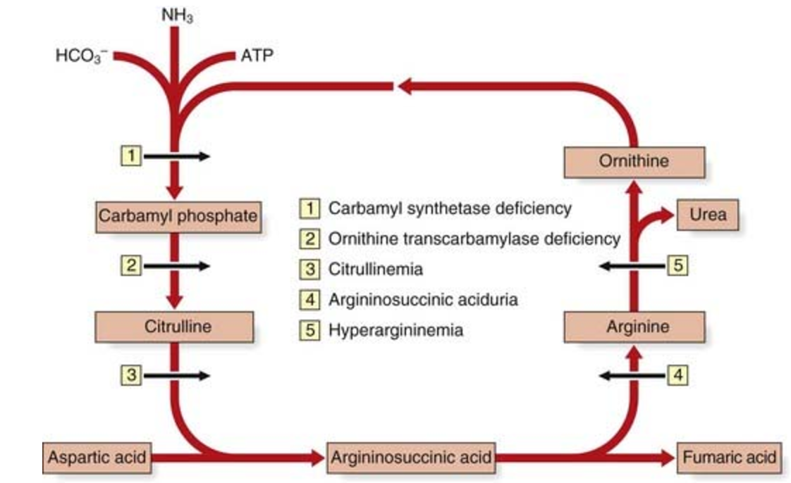
Inborn error: urea cycle disorder – suspect it
OTC most common, x-linked
Severe form in newborn males w/ OTC
DOL 2-3, hypotonia, lethargy, coma
Hyperventilation, resp alkalosis
May have seizures
Milder forms of OTC may present later
Males, and occ. female carriers
May even present in teens and adults
Stressor, protein load, certain drugs may precipitate (valproate, steroids)
FTT, recurrent vomiting episodes, lethargy & coma, encephalopathy
http://clinicalgate.com/biochemical-genetics/
Non-OTC urea cycle disorders also may present in severe form in neonates (both sexes) and in some cases milder forms later

Slide 30
Inborn error: urea cycle disorder – diagnose and manage it
Hallmark is high ammonia, typically > 500-1000 mcg/dL
Ddx from organic acidemias, which have less elevated ammonia
Suspect inborn error? Order CBC, Chem panel (iStat if ill appearing or seizure), LFTs, VBG, ammonia, lactate, pyruvate, bedside glucose, urine/serum ketones
Respiratory alkalosis typical early finding in urea cycle disorders
NPO (remove substrate), D10 ½ NS at 1.5 x maintenance
May need to add insulin to avoid hyperglycemia
Rapid reduction of ammonia to < 200 mcg/dL essential
Hemodialysis if > 1000 mcg/dL
Ammonia scavengers: sodium phenylacetate and sodium benzoate, arginine HCl
Supportive care, avoid valproate (increases ammonia), consult genetics immediately, admit to PICU

Slide 31
2 ½ year old girl with peri-anal rash and blood-streaked stools
2 ½ year old previously healthy girl complains of rectal area itching and pain with defecation
Mom then noticed bright red blood streaks in her stools
Area around the anus is bright red
She attends daycare and has one older sibling, age 5 years
Parents are divorced and she spends weekends with her father
Mom is unsure whether she suspects any possibility of sexual abuse
Temp 37.5, HR 98, RR 20, BP 80/35
Exam unremarkable except for well-demarcated, bright red, peri-anal rash; abdomen soft and nontender, patient well-appearing. Behavior and interactions with mom appropriate.
http://www.danderm-pdv.is.kkh.dk/atlas/5-4-4.html

Slide 32
Peri-anal strep: suspect it
Peri-anal streptococcal dermatitis caused by Group A beta-hemolytic strep (just like strep throat)
Occurs in children age 6 months to 10 years, particularly infants
Bright red, sharply demarcated, peri-anal rash
May spread to penis or vulva
Fissures, mucopurulent discharge, yellow crusting sometimes present
Other symptoms include: peri-anal itching, rectal pain, blood-streaked stools (1/3 of patients)
No fever, nontoxic

Slide 33
Peri-anal strep: diagnose and manage it
Can diagnose with rapid group A strep swab or culture similar to strep throat
Treatment with antibiotic course x 10 days
Penicillin VK
Amoxicillin may be better tolerated
Alternatives: clindamycin, clarithromycin, erythromycin
Topical mupirocin may be added an an adjunct to hasten resolution and for symptomatic relief
Relapses common and require re-treatment
For more information: http://pedemmorsels.com/perianal-strep-infection/ and for a good review of different types of diaper area rashes http://www.consultant360.com/articles/review-diaper-dermatitis-clinical-features-diagnosis-and-management

Slide 34
3 year old with malodorous nasal discharge
3 year old girl with malodorous right nasal discharge x 1 week
Previously healthy, full term born NSVD, no complications
Denies fever, cough, h/o allergies, trauma, headache, foreign body
Recently started preschool last month, doing well per teachers
VS: temp 37.7, HR 90, RR 24, BP 80/45, O2 sat 99% room air
Malodorous unilateral right nasal yellow-white discharge
Left nares unremarkable, right nares after discharge bulb suctioned, mildly swollen mucosa and turbinates, no septal hematoma, no foreign body seen

Slide 35
Nasal foreign body – suspect it
Most common chief complaint is patient admits to or was observed inserting FB
BUT, always suspect with unilateral (esp malodorous) nasal discharge
Even if FB not visualized, may be deep or tucked behind swollen turbinate or covered with mucus and not visible
Common FB: beads, buttons, food, pebbles, small toy parts, disc batteries
Commonly toddler (need manual dexterity) through preschool age
boogordoctor.com

Slide 36
Nasal foreign body – diagnose and manage it
Diagnose by looking into nares
Suction any discharge out first
If swollen mucosa, consider phenylephrine drops
Use nasal speculum if available & otoscope with bright light
Place a c-collar on the child to prevent side to side head motion
Only 2 FB need to be seen emergently by ENT now: disc battery or multiple magnets stuck across septum – can cause necrosis
Radiograph to r/o these if suspect FB but don’t see one
Various techniques for removal including balloon catheter, forceps, positive pressure “parent’s kiss”
Always check the other nares and the ears for more FB
If prolonged or much swelling / discharge, give antibiotics for sinusitis treatment / prevention
For more info: http://pemplaybook.org/podcast/foreign-bodies-in-the-head-and-neck/ and http://pedemmorsels.com/nasal-foreign-bodies-positive-pressure-technique/ and http://pedemmorsels.com/button-battery-nasal-foreign-body/
Button battery in nares

Slide 37
3 year old with fever and limp
3 year old boy with fever for 6 days, complaining also of pain in right leg in the knee area and limp
No known h/o trauma, no significant past medical history
VS temp 39.4, HR 120, RR 20, BP 80/40, O2 sat 99%
Right proximal tibia with area of point tenderness with redness and warmth of overlying skin, no fluctuance, antalgic gait
FROM knee and hip joints passively
WBC 18.8, 80% N, ESR 90
Xrays of pelvis, femur, tibia, fibula negative

Slide 38
Osteomyelitis – suspect it
Most common in pre-adolescent children
Prolonged fever, pain and point tenderness of a bone (limp if lower extremity), may have overlying redness and warmth
> 50% lower extremity, 5-15% humerus, also pelvis, spine, radius / ulna, clavicle
Most commonly hematogenous spread, but may be from local spread after minor trauma or skin infection
Neonates may present with sepsis
Elevated peripheral WBC with left shift, significantly elevated ESR and CRP

Slide 39
Osteomyelitis – diagnose and manage it
Order CBC, ESR and/or CRP, blood cultures (40% positive)
Plain films typically negative until 2nd-3rd week of illness, then may show lytic lesions, periosteal elevation or reaction
MRI to diagnose; if not available, scintigraphy (bone scan)
Consult orthopedic surgeon to obtain bone specimen for culture and evaluate for need for surgical drainage
Give IV antibiotics: organisms to cover: staph (including MRSA), strep, kingella kingae in < 5 yo, salmonella in sickle cell patients
For more information: http://pedemmorsels.com/osteomyelitis-kids/ and https://www.hawaii.edu/medicine/pediatrics/pedtext/s19c04.html and for a general approach to limping http://pemplaybook.org/podcast/please-just-stop-limping/

Slide 40
3 year old boy with sore throat, fever, neck stiffness
3yo boy with 24 hours of sore throat, fever, neck stiffness, decreased po intake
Negative PMH, no vomiting, diarrhea, headache, abdominal pain, coughing, known ill contacts
Temp 39.4, HR 150, RR 24, BP 80/40, O2 sat 97% room air
Patient ill-appearing, holding head midline and reluctant to range neck, alert and oriented
Oropharynx (quick look) erythematous, no exudate
Tender cervical lymphadenopathy

Slide 41
Retropharyngeal abscess – suspect it
Retropharyngeal space posterior to pharynx, anterior to prevertebral fascia, between carotid sheaths
Sudden onset sore throat, fever, neck pain and stiffness, dysphagia, usually ill-appearing
May hold neck in extension, have torticollis and/or decreased neck ROM
Pain with movement of larynx & trachea side to side “tracheal rock sign”
Stridor, trismus, drooling, airway obstruction are late signs
Children majority 6mo to 6yo (peak 2-4yo) but can occur in older / adults
Pharyngeal trauma from, eg, foreign body is a risk factor
pedclerk.uchicago.edu

Slide 42
Retropharyngeal abscess - diagnose and manage it
Screening plain film may show retropharyngeal soft tissue swelling, gas formation
False positive if neck not adequately extended
Definitive diagnosis: CT scan
Baseline CBC, ESR/CRP, blood cultures
Keep in position of comfort, give O2 as needed / tolerated, be prepared for difficult airway management / needle cricothyrotomy
3rd generation cephalosporin or ampicillin-sulbactam + clindamycin, add vancomycin if severe disease
Consult ENT surgeon early, admit to ICU setting
May require surgical drainage; may require airway management
en.wikipedia.org
For more info: https://pedclerk.uchicago.edu/page/retropharyngeal-abscesses
and http://pedemmorsels.com/retropharyngeal-abscess-look-for-limited-rom-of-neck/

Slide 43
3 year old with rash
3yo boy with rash for 2 days on left lower abdomen extending onto upper outer thigh
Previously healthy, no fever, no rash contacts
Rash includes clear yellow fluid-filled bullae, some of which have ruptured and have a thin colarette of scale
Temp 37.7, HR 110, RR 20, BP 80/40, O2 sat 100%, rash as shown, patient nontoxic, remainder of exam normal
http://paedsid.blogspot.com/2014/06/common-skin-infection-among-children-in.html

Slide 44
Bullous impetigo – suspect it
Most common in children < 5 years old
Hot, humid weather predisposes
Large (but usually < 3cm) thin-roofed bullae with clear yellow fluid, rupture to form erythematous base with collarette of scale (but no hone—crust as is typical for non-bullous impetigo)
Negative Nikolsky sign
Common on trunk, extremities, buttocks and perineum
Usually localized, as opposed to Staph Scalded Skin Syndrome
Due to Staph aureus strains that release exfoliative toxin A
A video on SSSS and bullous impetigo: https://www.youtube.com/watch?v=WWTgcNGNouY

Slide 45
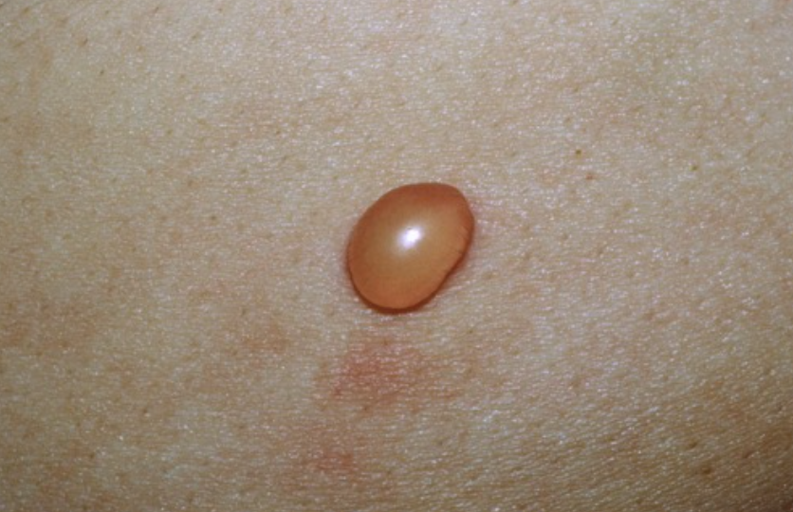
Bullous impetigo – diagnose and manage it
Clinical diagnosis
Small area of localized disease can be treated with topical mupirocin
Larger areas, prescribe oral anti-staphylococcal antibiotics (against MRSA if prevalent in local geographic area)
Differential diagnosis includes bullous reaction to a bug (eg flea) bite
Itchy, no erythematous base, typical bug bites nearby http://www.regionalderm.com/Regional_Derm/files/insect_bites.html
For more info on impetigo http://dontforgetthebubbles.com/impetigo/ and on differentiating from staph scalded skin syndrome http://www.pediatricsconsultantlive.com/articles/bullous-impetigo-neonate and for more pictures http://www.dermis.net/dermisroot/en/27052/diagnose.htm
Differential diagnosis: bullous reaction to bug bite

